Slide 1
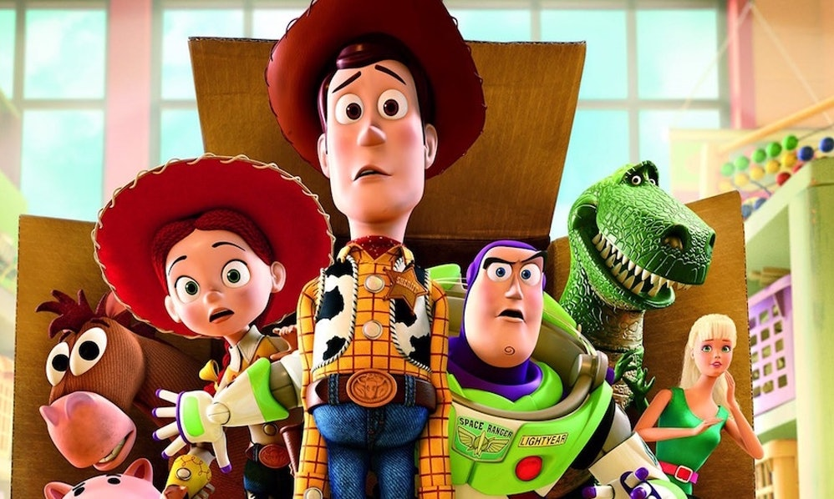

Graphics

Slide 2
Errors
What kind of bugs did you find in your code?
🤔

Slide 3

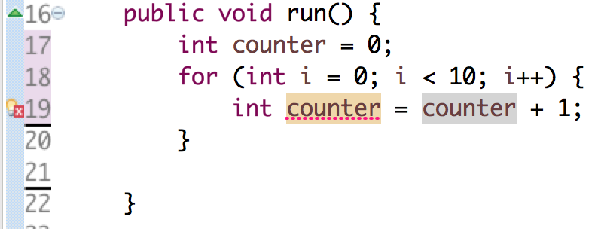

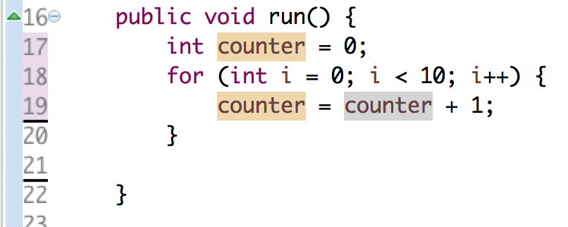
Reusing Variables
Duplicate variable age
You only need to tell Java the type of a variable once.

Slide 4

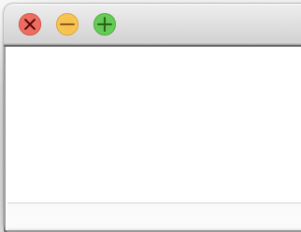
Updating Variable Values
“equals”
Evaluate right hand side
Store result in variable on left hand side
=
int year = 2019;
int prevYear = year;
year = year + 1; println(prevYear + " " + year);
println(prevYear + year);
???
year
prevYear
2019
2019
🤔

Slide 5
Updating Variable Values
“equals”
Evaluate right hand side
Store result in variable on left hand side
=
int year = 2019;
int prevYear = year;
year = year + 1; println(prevYear + " " + year);
println(prevYear + year);
2019 2020
4039
year
prevYear
2020
2019
🤔

Slide 6
Updating Variable Values
“equals”
Evaluate right hand side
Store result in variable on left hand side
=
double seconds = 60;
seconds--;
println(seconds);
59.0
seconds = seconds – 1;
???
int total = 15;
total /= 10;
println();
println(total);
1
total = total / 10;
???
The local variable age may not have been initialized
int age;
age = age + 1;
???
___
🤔

Slide 7


We Called Karel, Maybe
I’m back! Maybe
(2012)

Slide 8
Looping Beepers
How many beepers did Karel put down?
for (int i = 0; i < 5; i++) {
for (int j = 0; j < 4; j++) {
for (int k = 0; k < 3; k++) {
putBeeper();
}
} }
for (int i = 0; i < 3; i++) {
int countdown = 5;
while (countdown > 0) {
countdown--;
putBeeper();
}
}

Slide 9
Looping Beepers
How many beepers did Karel put down?
for (int i = 0; i < 5; i++) {
for (int j = 0; j < 4; j++) {
for (int k = 0; k < 3; k++) {
putBeeper();
}
} }
3 x
60
for (int i = 0; i < 3; i++) {
int countdown = 5;
while (countdown > 0) {
countdown--;
putBeeper();
}
}

Slide 10
Looping Beepers
How many beepers did Karel put down?
for (int i = 0; i < 5; i++) {
for (int j = 0; j < 4; j++) {
} }
4 x
3 x
60
for (int i = 0; i < 3; i++) {
int countdown = 5;
while (countdown > 0) {
countdown--;
putBeeper();
}
}

Slide 11
Looping Beepers
How many beepers did Karel put down?
for (int i = 0; i < 5; i++) {
}
5 x
4 x
3 x
60
for (int i = 0; i < 3; i++) {
int countdown = 10;
while (countdown > 0) {
countdown -= 2;
putBeeper();
}
}
15

Slide 12
Programming takes practice.

Slide 13
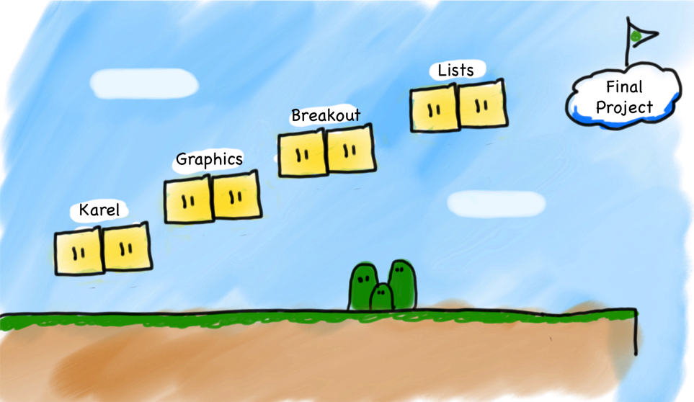
Our Second Step
Console
Programs
(but really, variables)
Notes:
Let's just jump straight into it!

Slide 14
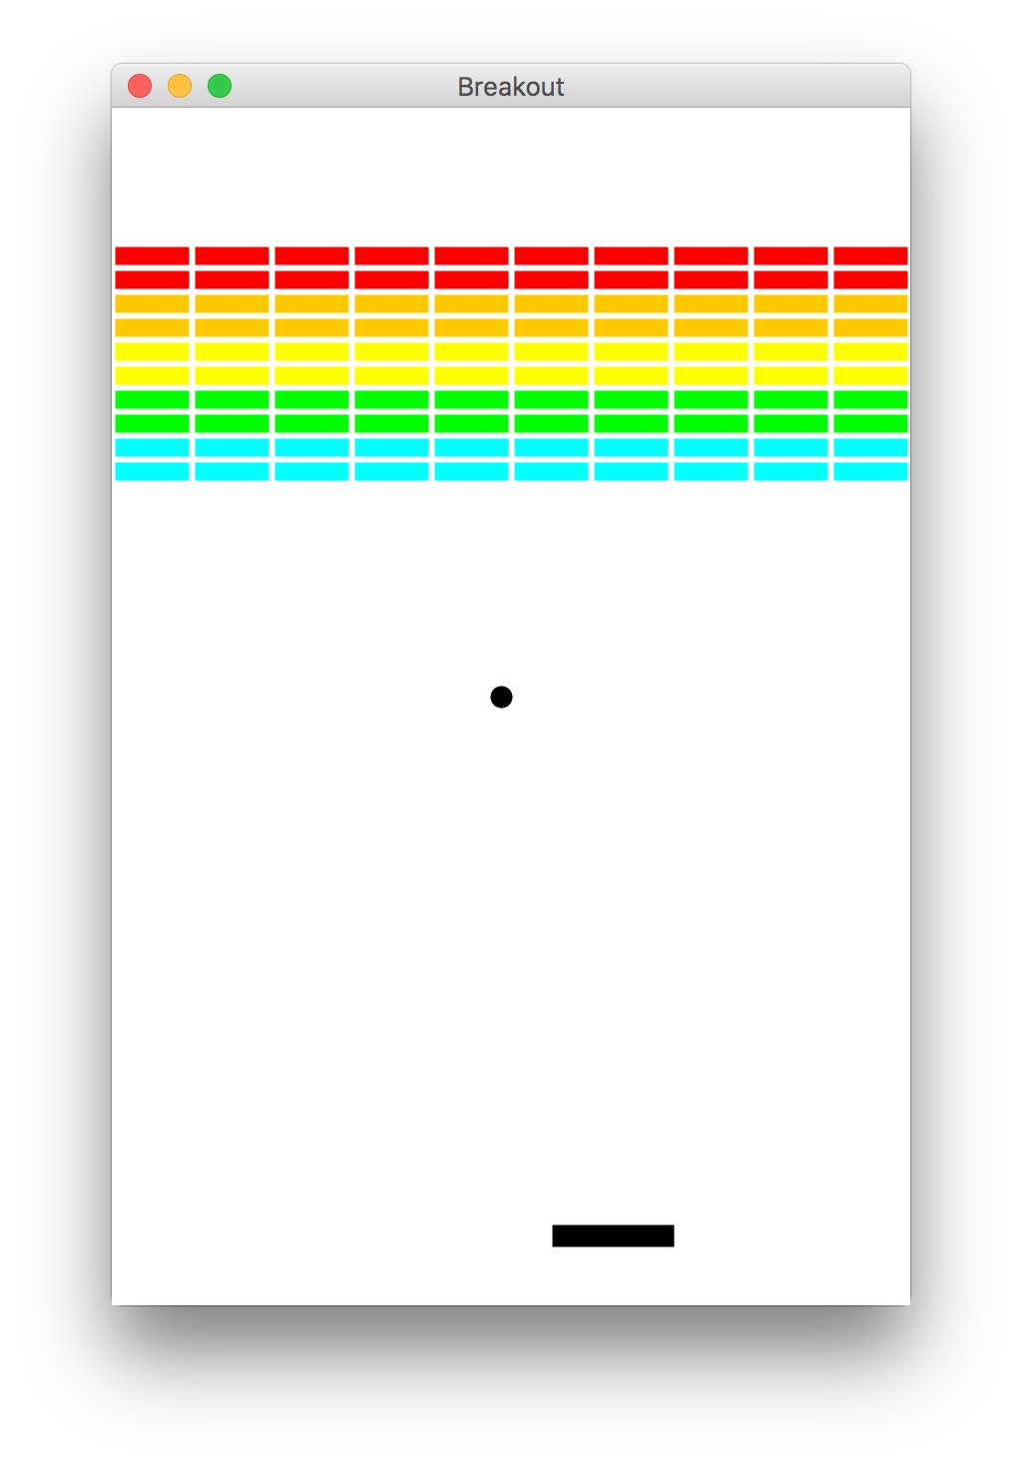
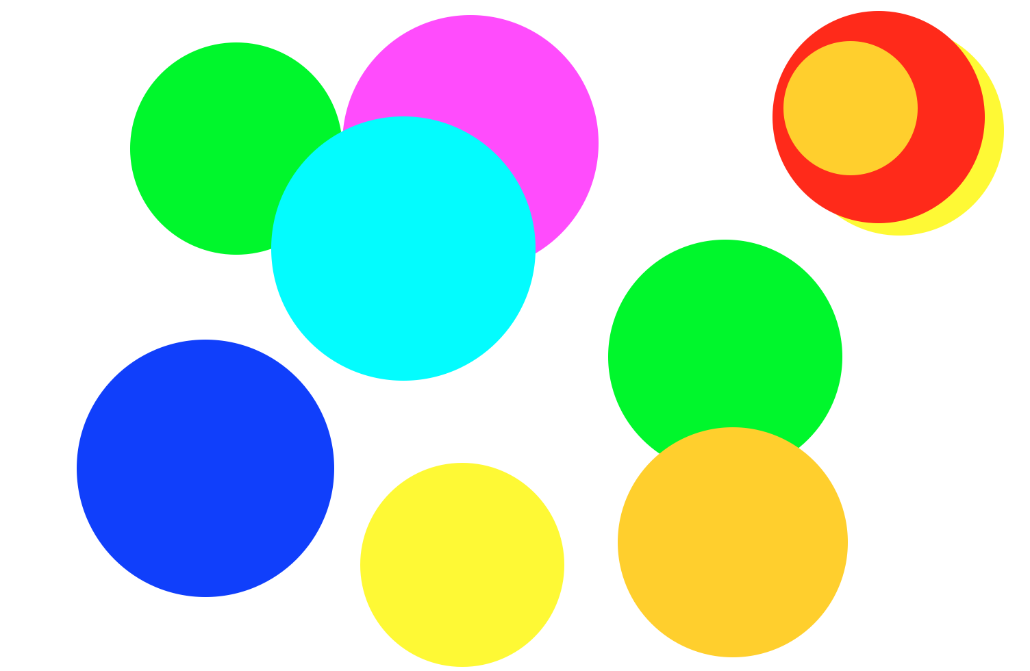
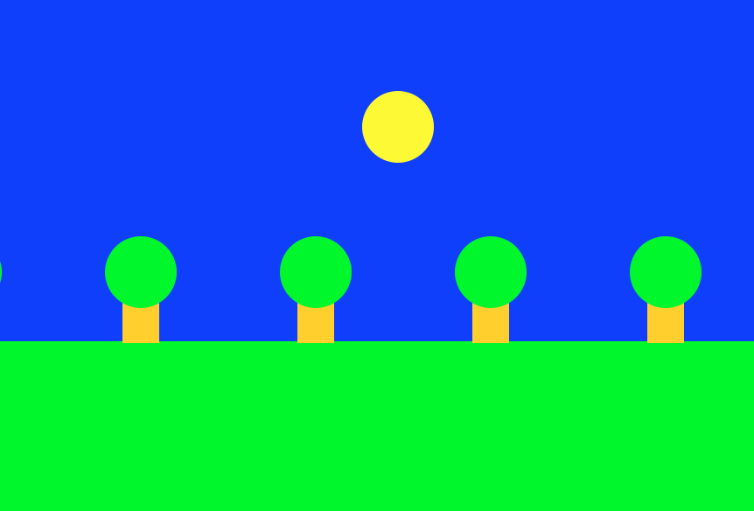
Beyond Console Programs

Slide 15
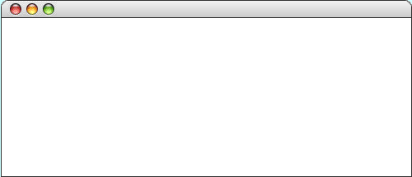
GRect
GRect is a variable that stores a rectangle.
As an example, the following run method displays a rectangle
public class WonderfulRect extends GraphicsProgram {
public void run() {
GRect rect = new GRect(220, 120);
rect.setFilled(true);
rect.setColor(Color.BLUE);
add(rect, 50, 50);
}
}
WonderfulRectangle

Slide 16
GRect
GRect is a variable that stores a rectangle.
As an example, the following run method displays a rectangle
public class WonderfulRect extends GraphicsProgram {
public void run() {
GRect rect = new GRect(220, 120);
rect.setFilled(true);
rect.setColor(Color.BLUE);
add(rect, 50, 50);
}
}
width:220
WonderfulRectangle
height:120
rect

Slide 17
GRect
GRect is a variable that stores a rectangle.
As an example, the following run method displays a rectangle
public class WonderfulRect extends GraphicsProgram {
public void run() {
GRect rect = new GRect(200, 200);
rect.setFilled(true);
rect.setColor(Color.BLUE);
add(rect, 100, 50);
}
}
⚠️ You must call add()to display things!
WonderfulRect
Coordinates for a rectangle are the top left corner.
y:50
x:100

Slide 18
Graphics Coordinates
0,0
40,20
120,40
getHeight();
40,120
getWidth();

Slide 19
Two GRects
GRect is a variable that stores a rectangle.
As an example, the following run method displays a rectangle
public class WonderfulRect extends GraphicsProgram {
public void run() {
GRect rect = new GRect(200, 200);
rect.setFilled(true);
rect.setColor(Color.BLUE);
add(rect, 100, 50);
}
}
⚠️ You must call add()to display things!
WonderfulRect
Coordinates for a rectangle are the top left corner.
y:50
x:100

Slide 20
Two GRects
GRect rect = new GRect(100, 100);
rect.setFilled(true);
rect.setColor(Color.BLUE);
add(rect, 50, 50);
rect.setColor(Color.GREEN);
add(rect, 150, 50);
TwoGRects
⚠️ multiple add() commands just move things around!
GRect rectB = new GRect(100, 100);
rectB.setFilled(true);
rectB.setColor(Color.BLUE);
add(rectB, 50, 50);
GRect rectG = new GRect(100, 100);
rectG.setFilled(true);
rectG.setColor(Color.GREEN);
add(rectG, 150, 50);
TwoGRects
This draws two separate rectangles.

Slide 21
Questions?

Slide 22
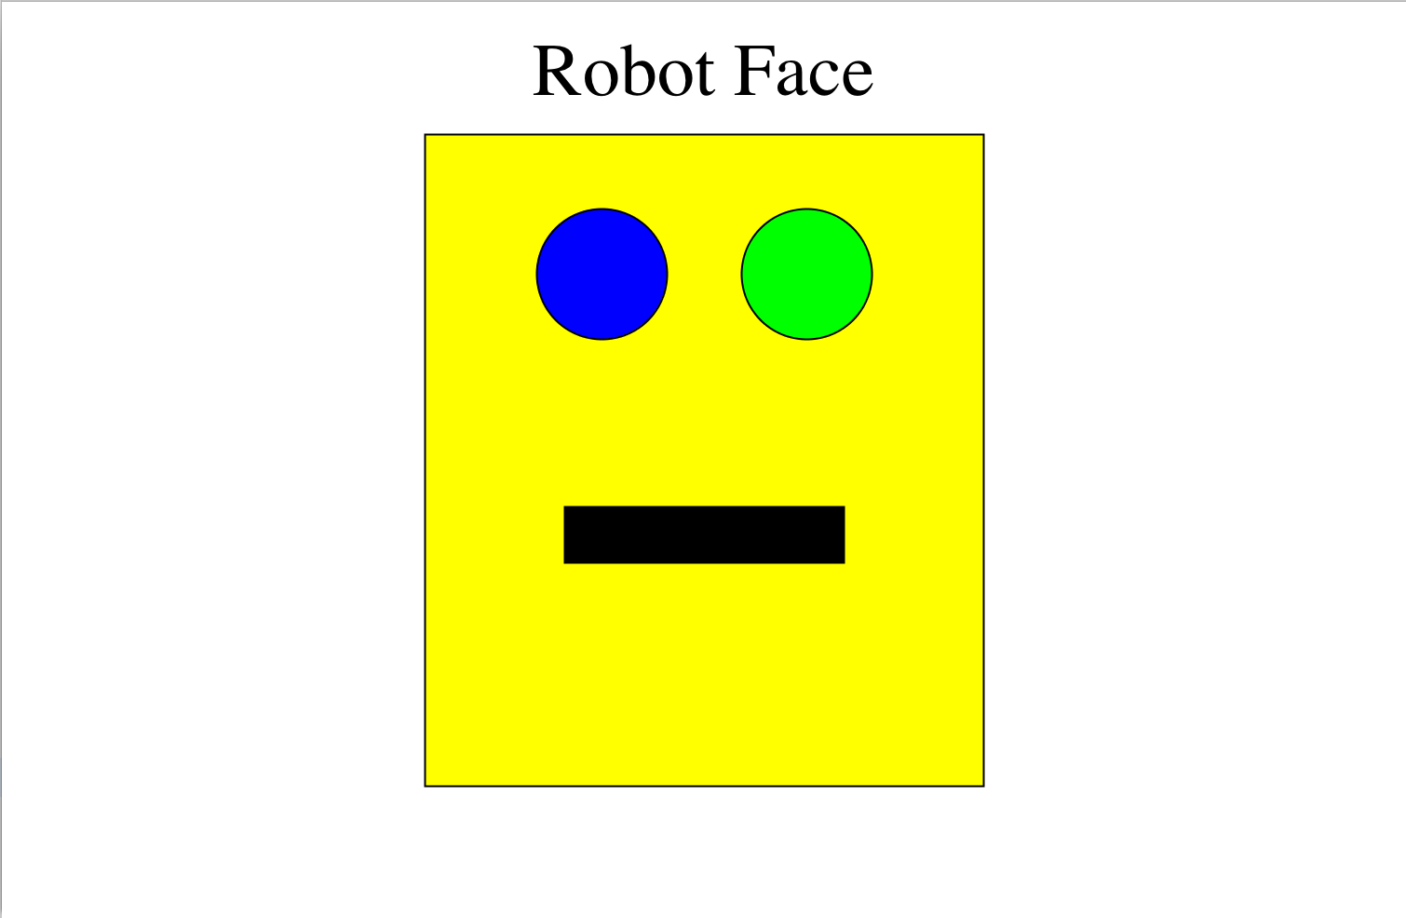
Karel’s Grandpa

Slide 23
Karel’s Grandpa
public void run() {
drawHead();
drawMouth();
drawLabel();
drawEyes();
}

Slide 24
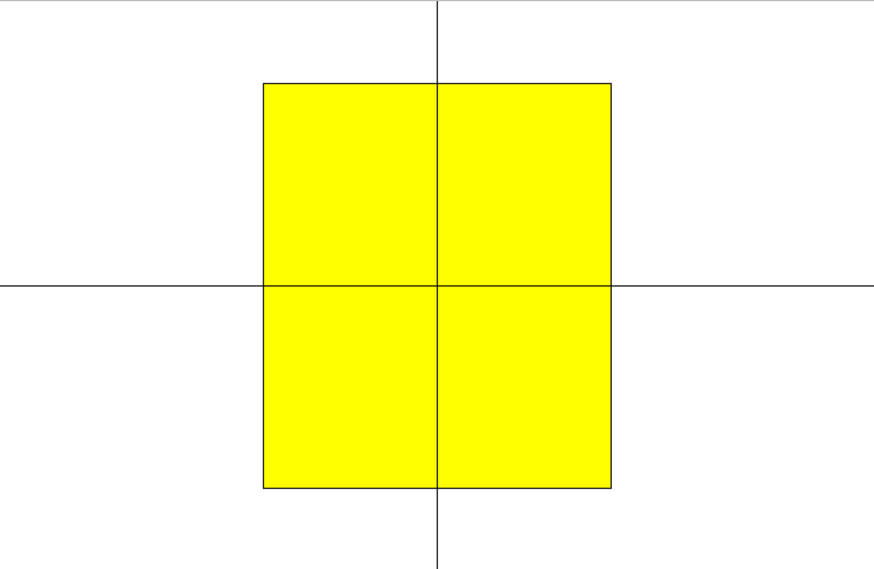
drawHead()
(x, y)?

Slide 25
drawHead()
rect.getWidth()/2
getWidth()/2
double headX = getWidth()/2 - rect.getWidth()/2;
or
double headX = (getWidth() – rect.getWidth())/2;

Slide 26
drawHead()
getHeight() / 2
rect.getHeight() / 2
double headY = getHeight()/2 - rect.getHeight()/2;
or
double headY = (getHeight() – rect.getHeight())/2;

Slide 27
Constants
Once constants are defined, they cannot be changed anywhere.
It has scary syntax, but is easy to use.
public class RobotFace extends GraphicsProgram {
/* The distance from the top of the head * to the top of the mouth */
private static final int MOUTH_Y_OFFSET = 200;
public void run() {
drawHead();
drawMouth();
drawLabel();
drawEyes();
}
}

Slide 28
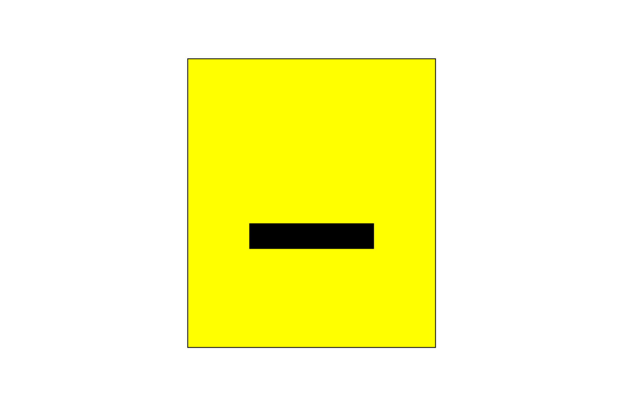
drawMouth()
/* The distance from the top of the head to the top of the mouth */
private static final int MOUTH_Y_OFFSET = 200;

Slide 29
drawMouth()
public class RobotFace extends GraphicsProgram {
private static final int MOUTH_Y_OFFSET = 200;
... // more constants, hidden
private void drawMouth() {
double headX = ...;
double headY = ...;
double mouthX = ...
double mouthY = ????????
GRect mouth = new GRect(
mouthX, mouthY,
MOUTH_WIDTH, MOUTH_HEIGHT);
?????????
?????????
}
... // more code
}
(headX, headY)
MOUTH_Y_OFFSET
(x, y)?

Slide 30
drawMouth()
public class RobotFace extends GraphicsProgram {
private static final int MOUTH_Y_OFFSET = 200;
... // more constants, hidden
private void drawMouth() {
double headX = ...;
double headY = ...;
double mouthX = ...
double mouthY = ????????
GRect mouth = new GRect(
mouthX, mouthY,
MOUTH_WIDTH, MOUTH_HEIGHT);
?????????
?????????
}
... // more code
}
headY + MOUTH_Y_OFFSET;
MOUTH_Y_OFFSET
mouth.setFilled(true);
(x, y)?
add(mouth);

Slide 31
Karel’s Grandpa
public void run() {
drawHead();
drawMouth();
drawLabel();
drawEyes();
}
✓
✓

Slide 32
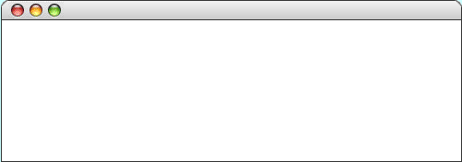
GLabel
A variable that represents text.
public class HelloProgram extends GraphicsProgram {
public void run() {
GLabel label = new GLabel(
”hello, world”, 100, 75);
label.setFont(“SansSerif-36”);
label.setColor(Color.RED);
add(label);
}
}
HelloProgram
HelloProgram
hello, world

Slide 33
GLabel
A variable that represents text.
public class HelloProgram extends GraphicsProgram {
public void run() {
GLabel label = new GLabel(
”hello, world”, 100, 75);
label.setFont(“SansSerif-36”);
label.setColor(Color.RED);
add(label);
}
}
HelloProgram
HelloProgram
75
100
hello, world

Slide 34
drawLabel()
/* The distance from the top of the screen to the base of the label */
private static final int LABEL_Y = 50;

Slide 35
drawLabel()
public class RobotFace extends GraphicsProgram {
/* The distance from the top of the screen * to the base of the label */
private static final int LABEL_Y = 50;
...
private void drawLabel() {
GLabel label = new GLabel("Robot Face");
label.setFont(”Times New Roman-50");
/* Put the label on the canvas
* in the right place
*/
}
... // more code
}
?
Learned during exercise
🤔

Slide 36
drawLabel()
Programming time!
Learned during exercise

Slide 37
Karel’s Grandpa
public void run() {
drawHead();
drawMouth();
drawLabel();
drawEyes();
}
✓
✓
✓

Slide 38
GOval
The GOval class represents an elliptical shape defined by the boundaries of its enclosing rectangle.
As an example, the following run method creates the largest oval that fits within the canvas:
public void run() {
GOval oval = new GOval(getWidth(), getHeight());
oval.setFilled(true);
oval.setColor(Color.GREEN);
add(oval, 0, 0);
}
LargestOval

Slide 39
drawEyes()
/* The diameter of each eye*/
private static final int EYE_DIAMETER = 70;
/* The distance from the top of the head to the top of the eyes*/
private static final int EYE_Y_OFFSET = 40;
/* The distance in between the two eyes */
private static final int EYE_X_SEPARATION = 40;

Slide 40

drawEyes()
(leftX, eyeY)?
(rightX, eyeY)?
double eyeY = headY + EYE_Y_OFFSET;
double leftX = getWidth()/2 - EYE_X_SEPARATION/2 - EYE_DIAMETER;
double rightX = getWidth()/2 + EYE_X_SEPARATION/2;

Slide 41
drawEyes()
Programming time!

Slide 42
Karel’s Grandpa
public void run() {
drawHead();
drawMouth();
drawLabel();
drawEyes();
}
✓
✓
✓
✓

Slide 43
Not Karel’s Grandpa
?
public void run() {
drawMouth();
drawLabel();
drawEyes();
drawHead();
}
⚠️ Order of add()matters!

Slide 44
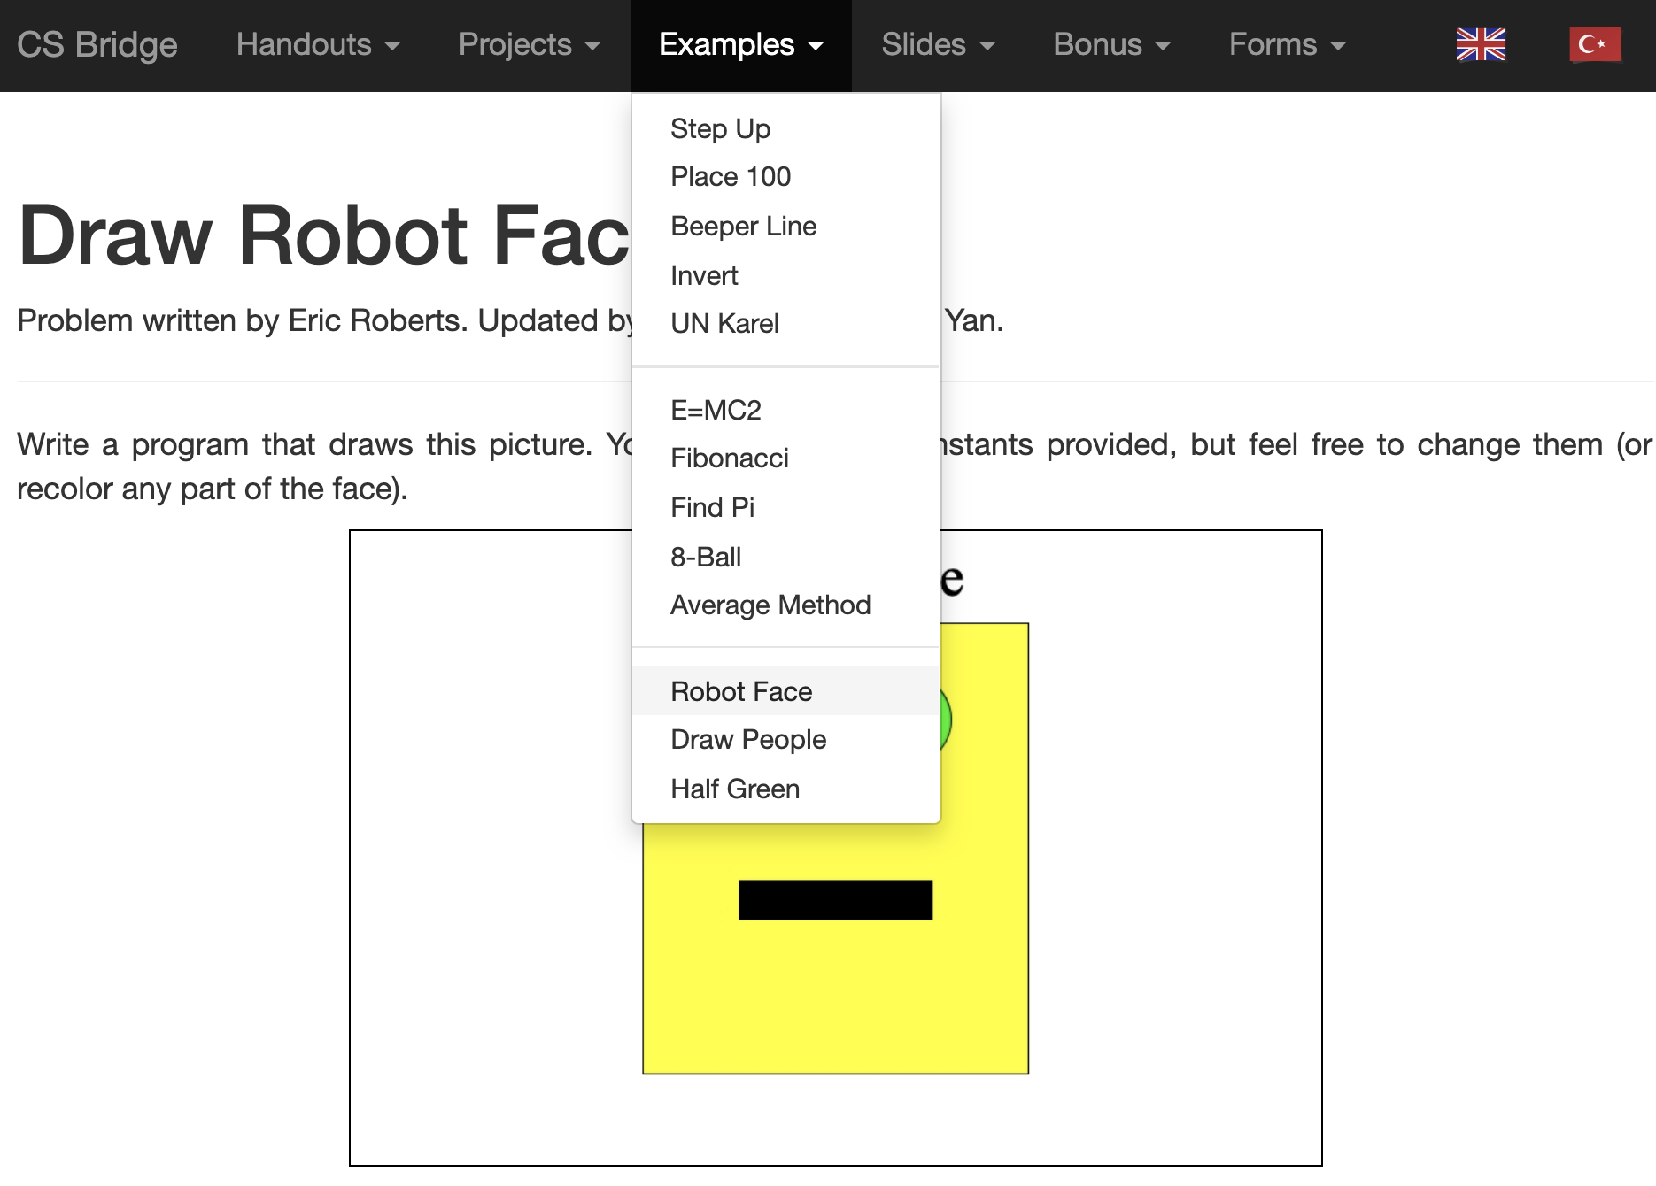
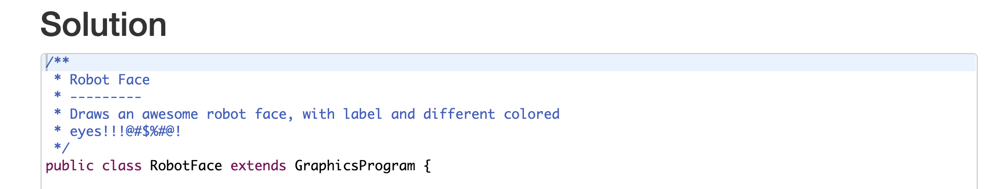
Karel’s Grandpa
Read the solution code if you get stuck!

Slide 45
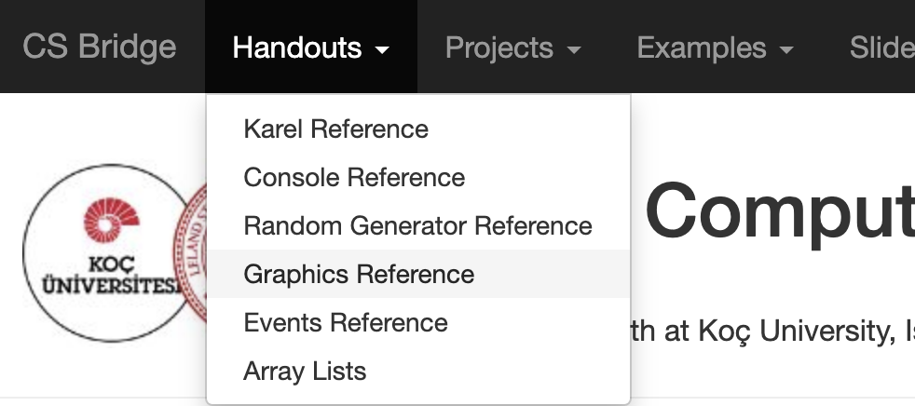
Graphics Methods Reference

Slide 46
Graphics Methods
add(object)
Adds the object to the canvas at the front of the stack
add(object, x, y)
Moves the object to (x, y) and then adds it to the canvas
remove(object)
Removes the object from the canvas
removeAll()
Removes all objects from the canvas
getElementAt(x, y)
Returns the frontmost object at (x, y), or null if none
getWidth()
Returns the width in pixels of the entire canvas
getHeight()
Returns the height in pixels of the entire canvas
setBackground(c)
Sets the background color of the canvas to c.
pause(milliseconds)
Pauses the program for the specified time in milliseconds
waitForClick()
Suspends the program until the user clicks the mouse

Slide 47
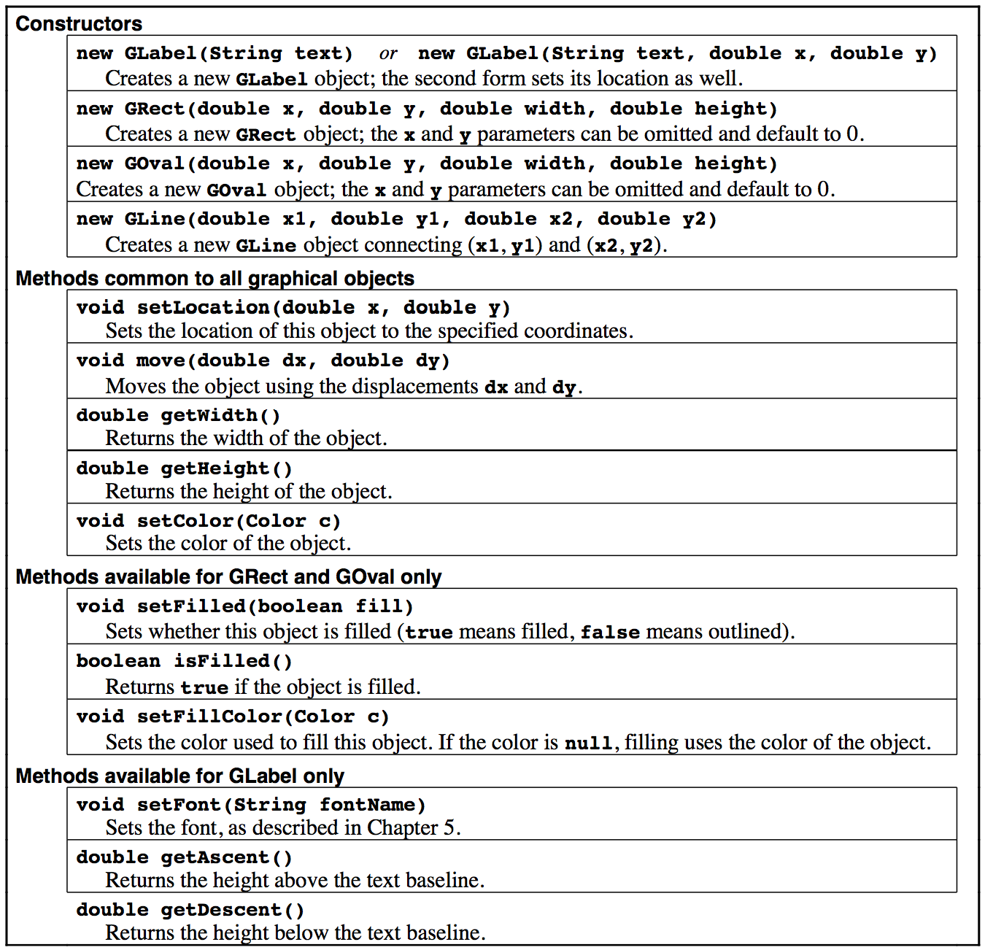
Reference Sheet

Slide 48
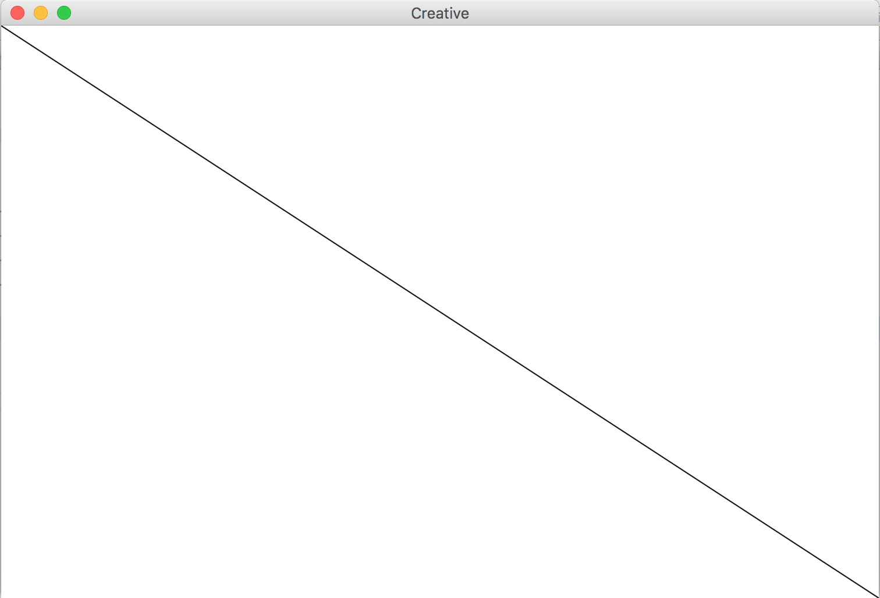
GLine
The GLine class represents a line defined by a start point and an end point.
As an example, the following run method creates a diagonal line across the canvas:
public void run() {
GLine line = new GLine(0,0, getWidth(), getHeight());
add(line);
}

Slide 49
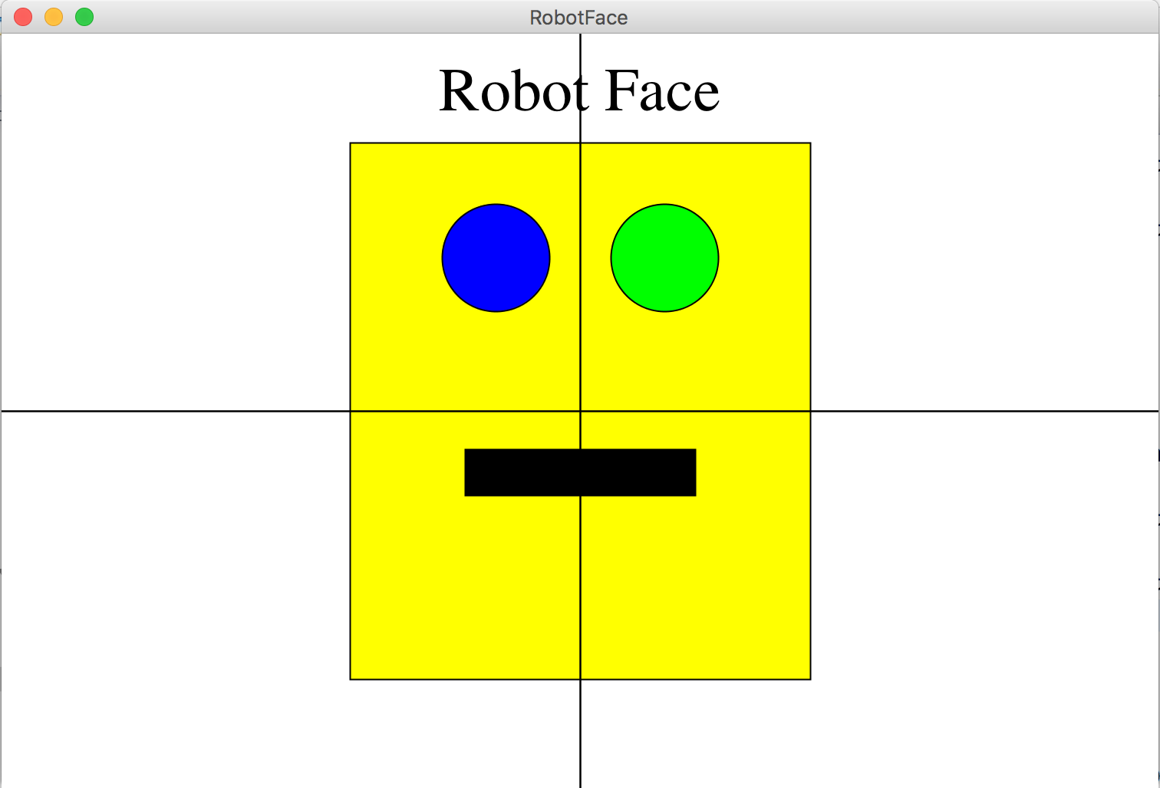
(bonus) Karel’s Grandpa

